Slide 1
Optical Measurement Setups at PIXlab
Yu Di
Mar 13, 2025

Slide 2
Part I: Transmittance and Reflectance

Slide 3
Setup for characterizing transmittance/reflectance spectra
Optical signal
Trigger signal
Ethernet/USB connection
20-MHz-FSR MZI
VOA
PD 1
Oscilloscope, ch3
Electrical signal
PD 2
Oscilloscope, ch1
50%
Tunable Laser
Polarization Controller
50%
50%
C-band circulator
50%
PD 4,
port 1
Oscilloscope, ch2 (trig source)
1
2
90%
DUT
ISO
3
10%
50%
PD 4,
port 2
NanoTrak
Computer
USB
PD 3
Network Switch
MZI: Mach-Zehnder interferometer
PD: photodetector
ISO: isolator
DUT: device under test
Oscilloscope, ch4

Slide 4
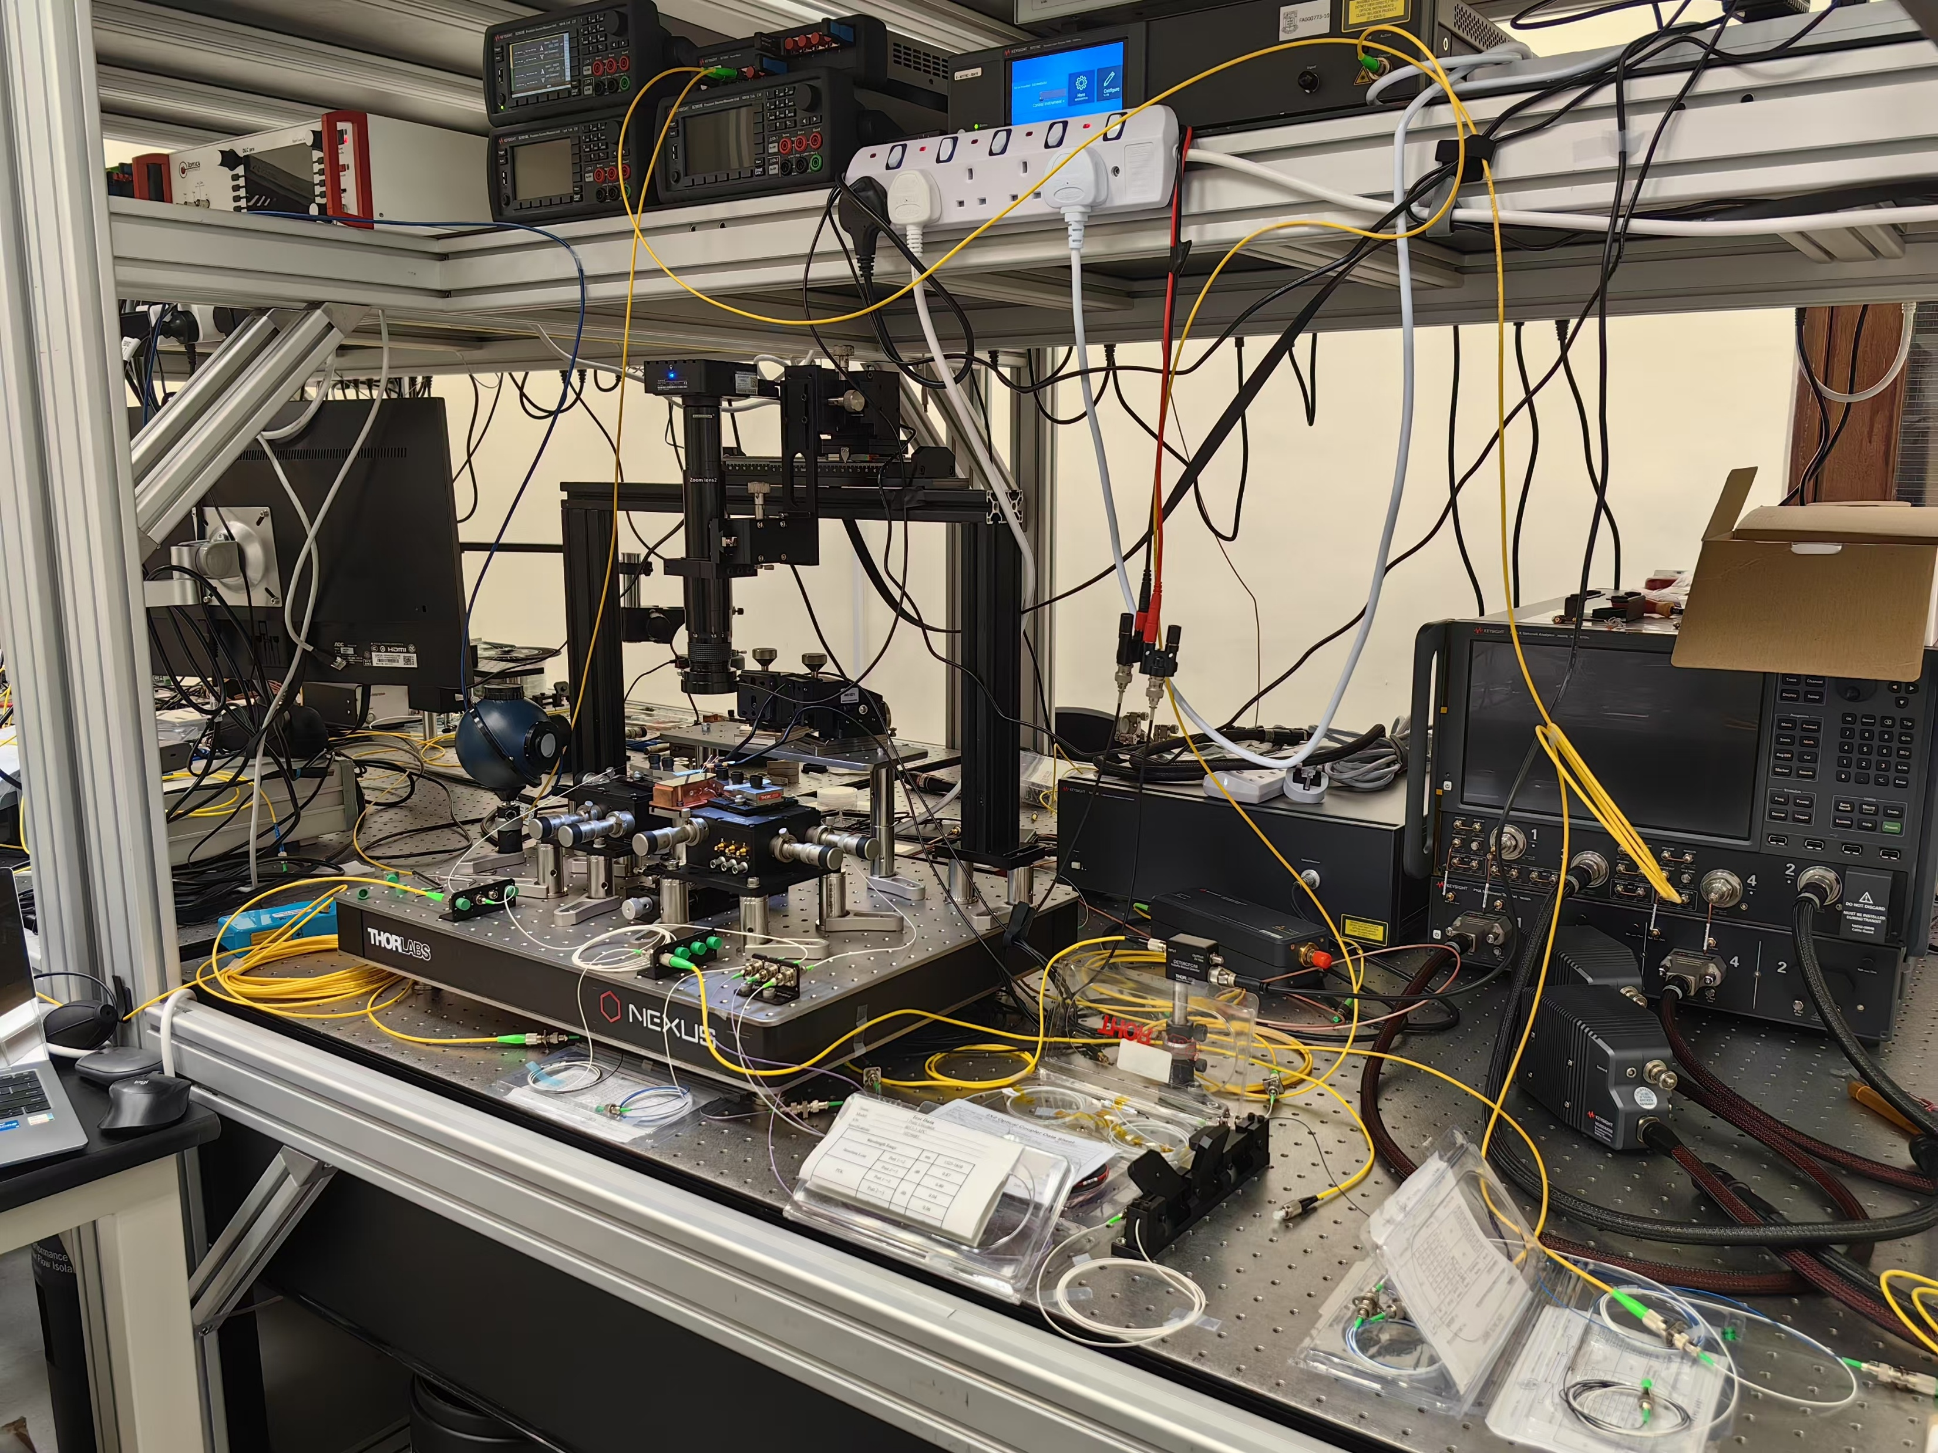
Relevant equipment
Tunable laser: Keysight N7778C
MZI: fiber-based, path length difference 10 m, FSR 20 MHz
PD 1: Thorlabs PDB415C
PD 2&3: Newport 1811-FC x2
PD 4: Keysight N7745C
Oscilloscope: Keysight MSOX6004A
Polarization controller: manual three-ring polarization controller with single-mode fiber

Slide 5
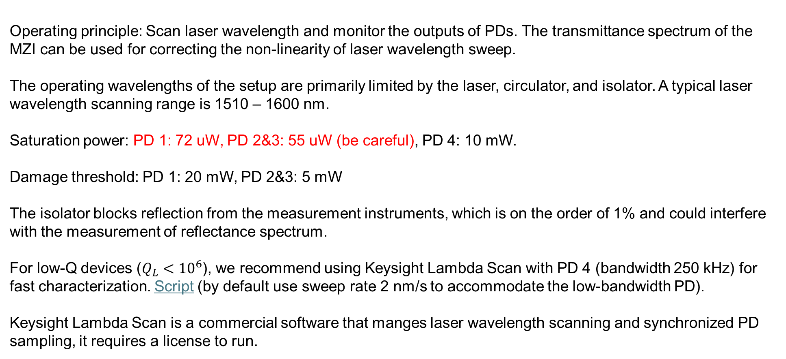
Note
Operating principle: Scan laser wavelength and monitor the outputs of PDs. The transmittance spectrum of the MZI can be used for correcting the non-linearity of laser wavelength sweep.
The operating wavelengths of the setup are primarily limited by the laser, circulator, and isolator. A typical laser wavelength scanning range is 1510 – 1600 nm.
Saturation power: PD 1: 72 uW, PD 2&3: 55 uW (be careful), PD 4: 10 mW.
Damage threshold: PD 1: 20 mW, PD 2&3: 5 mW
The isolator blocks reflection from the measurement instruments, which is on the order of 1% and could interfere with the measurement of reflectance spectrum.
For low-Q devices ($Q_{L}<{10}^{6}$), we recommend using Keysight Lambda Scan with PD 4 (bandwidth 250 kHz) for fast characterization. Script (by default use sweep rate 2 nm/s to accommodate the low-bandwidth PD).
Keysight Lambda Scan is a commercial software that manges laser wavelength scanning and synchronized PD sampling, it requires a license to run.

Slide 6
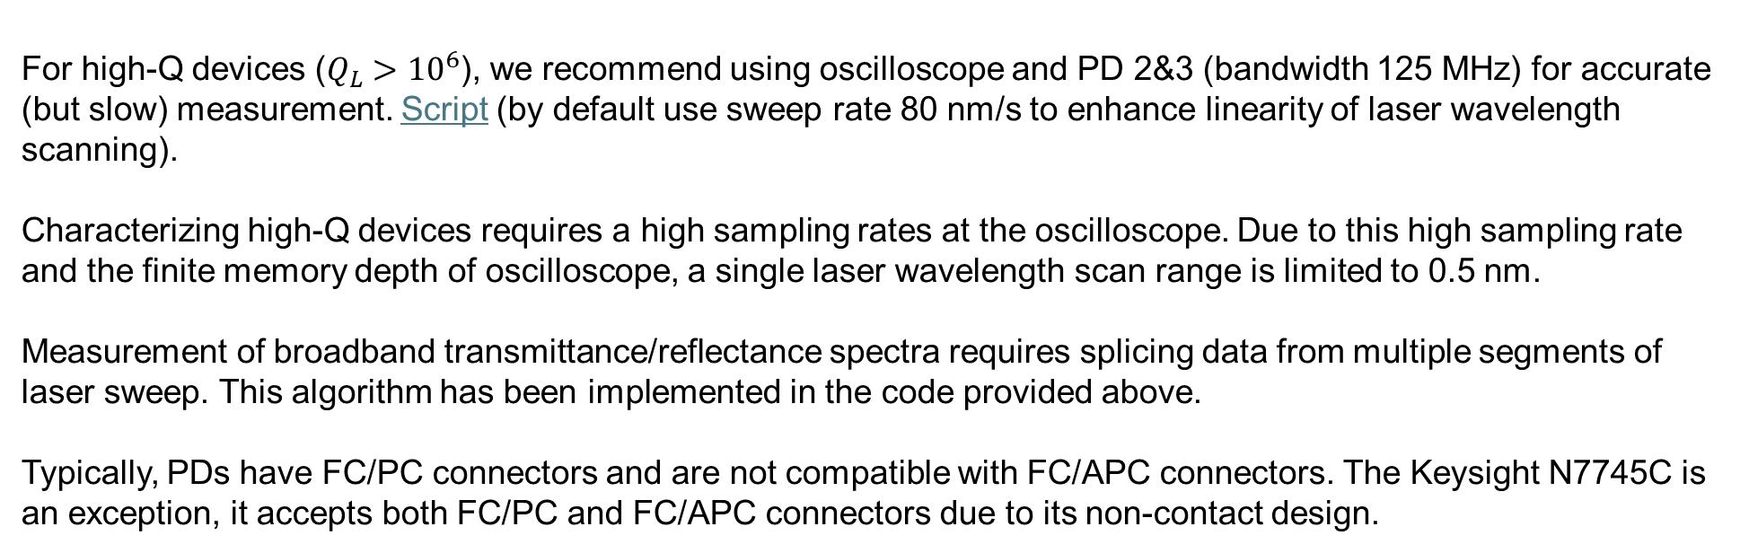
Note (continued)
For high-Q devices ($Q_{L}>{10}^{6}$), we recommend using oscilloscope and PD 2&3 (bandwidth 125 MHz) for accurate (but slow) measurement. Script (by default use sweep rate 80 nm/s to enhance linearity of laser wavelength scanning).
Characterizing high-Q devices requires a high sampling rates at the oscilloscope. Due to this high sampling rate and the finite memory depth of oscilloscope, a single laser wavelength scan range is limited to 0.5 nm.
Measurement of broadband transmittance/reflectance spectra requires splicing data from multiple segments of laser sweep. This algorithm has been implemented in the code provided above.
Typically, PDs have FC/PC connectors and are not compatible with FC/APC connectors. The Keysight N7745C is an exception, it accepts both FC/PC and FC/APC connectors due to its non-contact design.

Slide 7
Part II: Laser LIV Characteristic

Slide 8
Setup for measuring laser LIV characteristic (free-space laser output)
Optical signal
Trigger signal
Ethernet/USB connection
Electrical signal
SMU, ch1
Laser
Integrating sphere
PD
SMU, ch2
Computer
SMU: source/measure unit
PD: photodetector

Slide 9
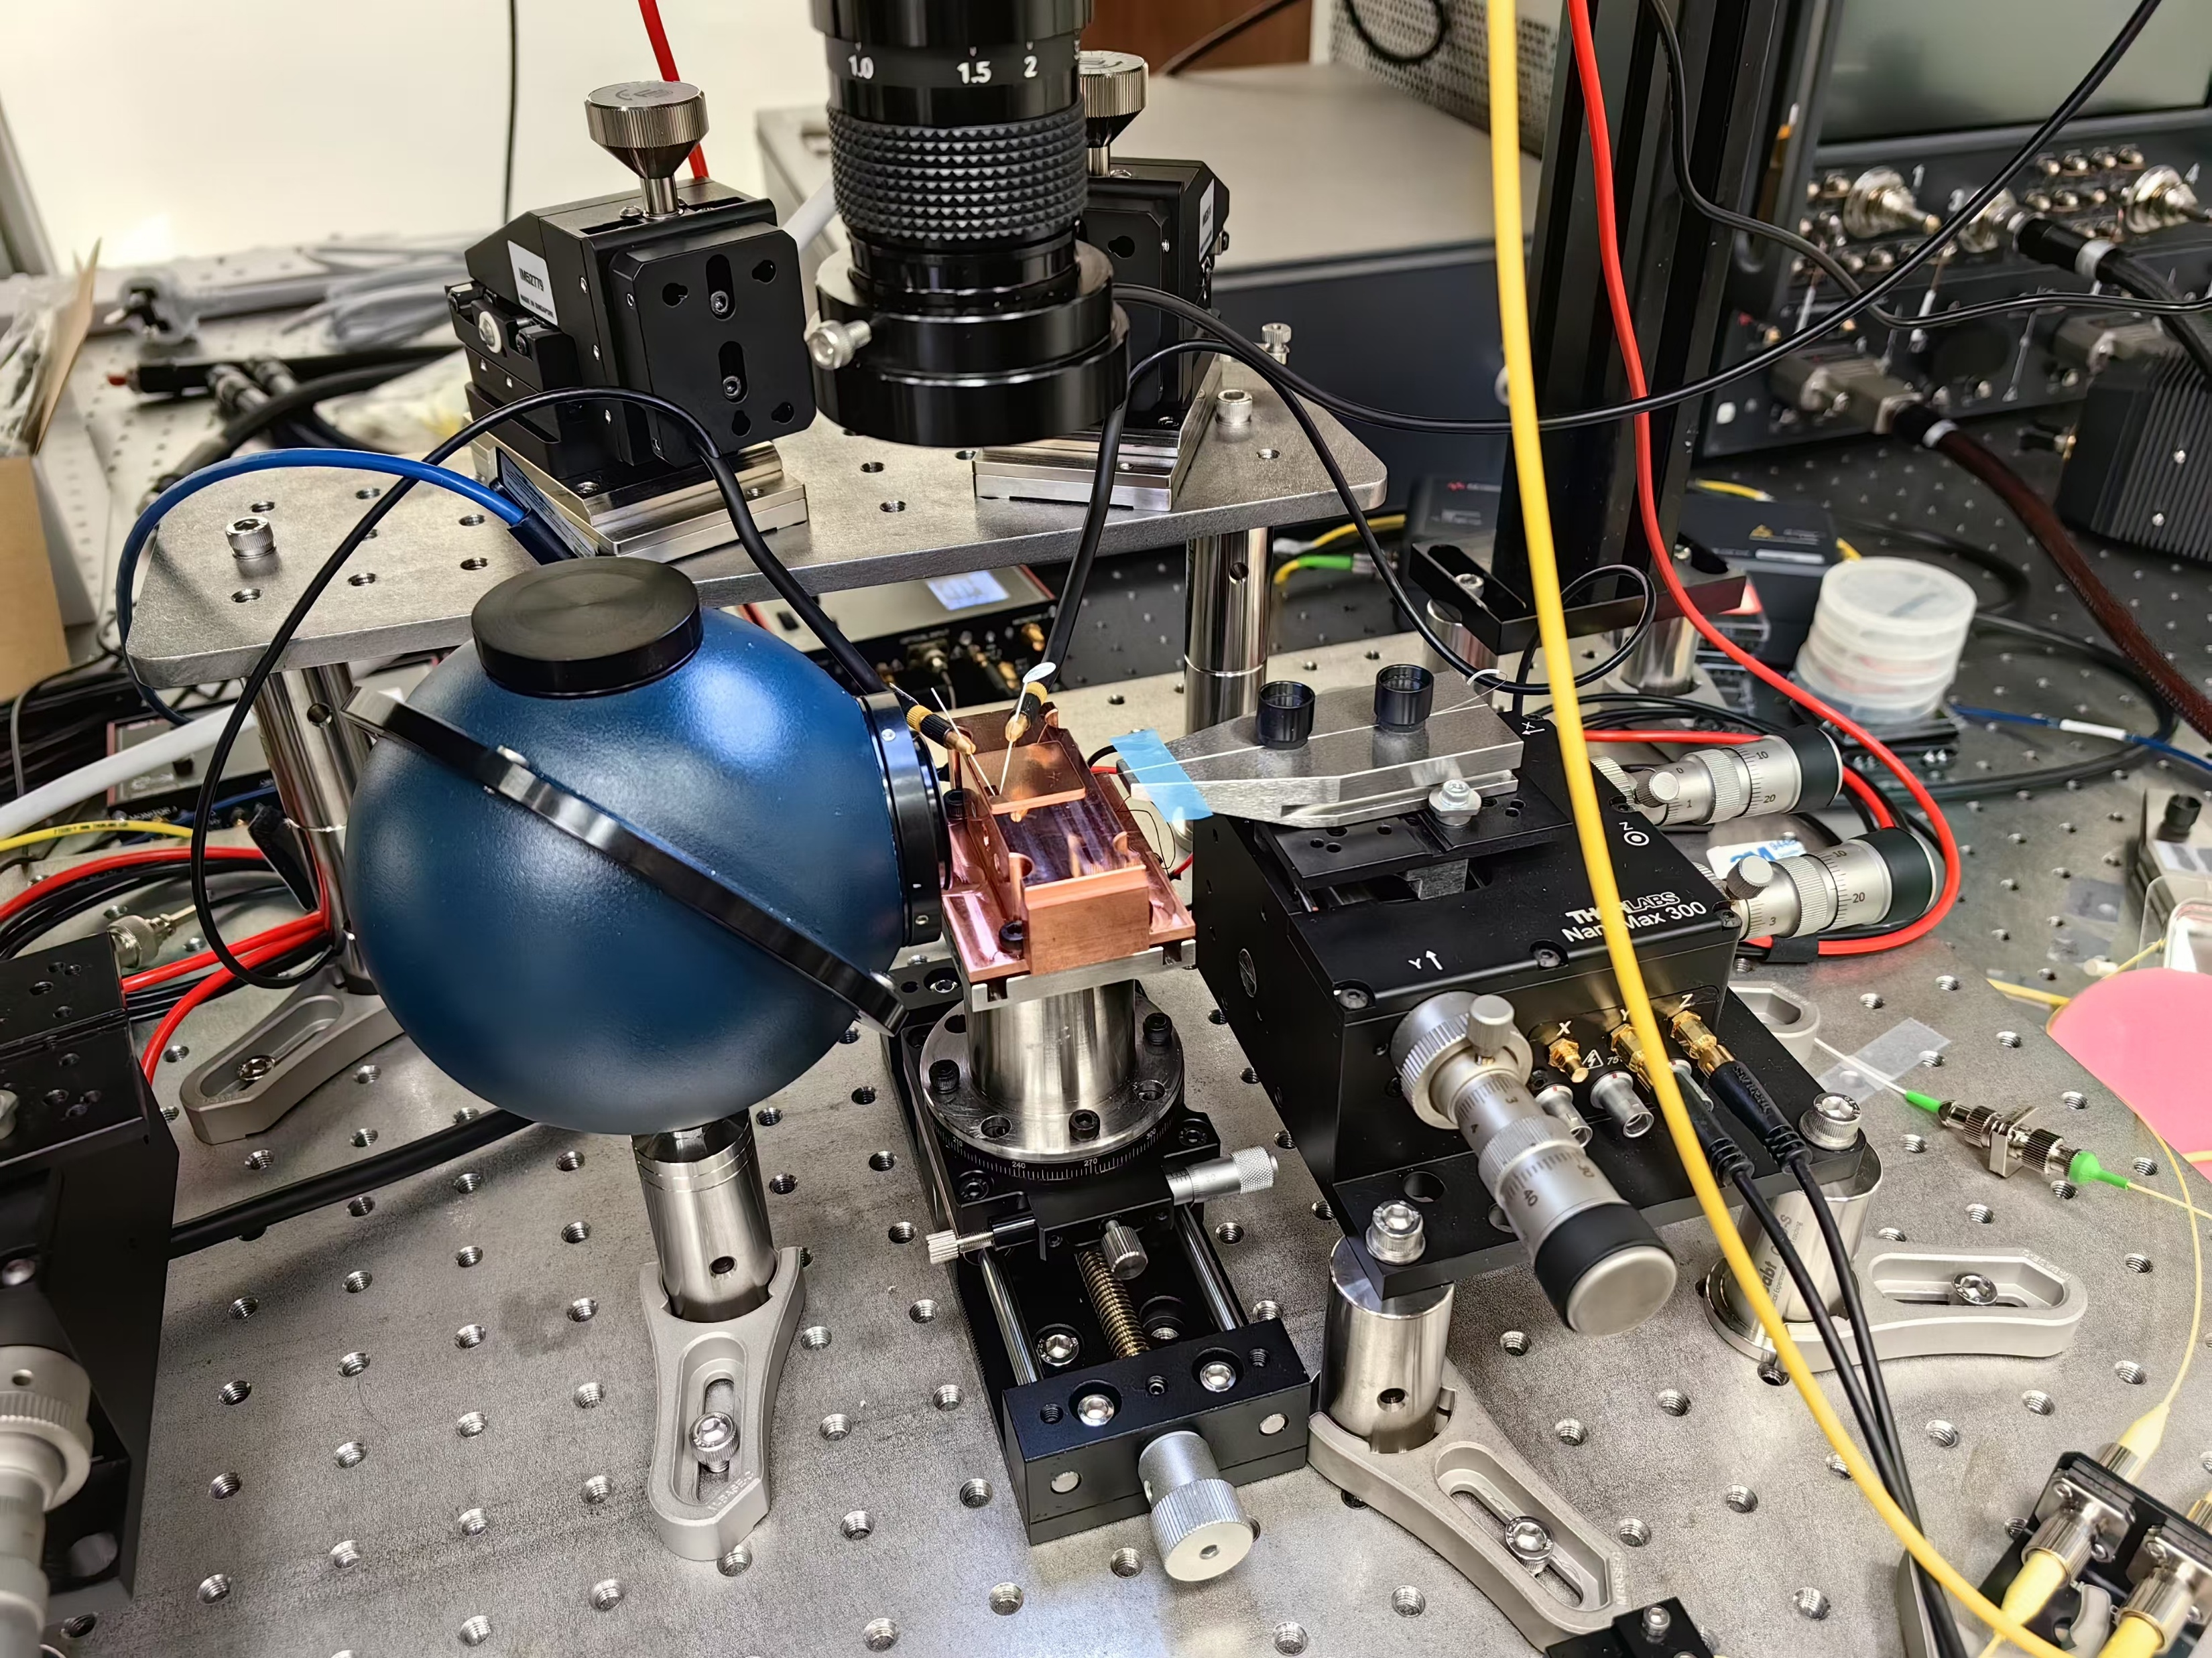
Relevant equipment
SMU: Keysight B2902B
Integrating sphere: Newport 819D-SF-4
PD: Newport 818-IR/DB

Slide 10
Note
Operating principle: Scan laser pump current and monitor the output power with a PD.
The pump current scanning and photocurrent sampling must be synchronized. The easiest approach is to use the the same internal trigger source for the two channels of a Keysight B2902B SMU, which serve as pump and measurement, respectively.
The LIV characterization with Keysight B2902B SMU is implemented with this script.
The PD in the integrating sphere features a saturation power of 2 W. This high value is attributed to an OD-3 optical attenuator packaged with the PD.
Typically, the pump voltage for a semiconductor laser should not exceed 4 V to avoid damage to the device.

Slide 11
Setup for measuring laser LIV characteristic (fiber-coupled laser output)
Optical signal
Trigger signal
Ethernet/USB connection
Electrical signal
SMU, ch1
Laser
Edge-coupling stage
Isolator
PD
SMU, ch2
Computer
SMU: source/measure unit
PD: photodetector

Slide 12
Relevant equipment
SMU: Keysight B2902B
Edge-coupling stage: Thorlabs MAX301/M
PD: Thorlabs DET08CFC/M

Slide 13
Note
The LIV characterizations for fiber-coupled laser output and free-space output are automated with the same script. The only difference lies in the setting of PD responsivity.
Here for characterization a fiber-coupled laser output, the isolator is essential. If it is absent, the laser output can be significantly altered by the reflection from the measurement instruments.
In the case of integrating sphere-based measurement, the isolator is unnecessary since the backreflection from the integrating sphere is very weak.
The fiber-coupled PD Thorlabs DET08CFC/M has a saturation power of 40 mW. High-power laser output must be attenuated before delivered to the PD.

Slide 14
Part III: Optical Spectrum

Slide 15
Setup for optical spectrum characterization
Optical signal
Trigger signal
Ethernet/USB connection
Electrical signal
SMU
Laser
Edge-coupling stage
Isolator
OSA
Computer
SMU: source/measure unit
OSA: optical spectrum analyzer

Slide 16
Relevant equipment
SMU: Keysight B2901BL or B2902B
Edge-coupling stage: Thorlabs MAX301/M
OSA: Yokogawa AQ6370E

Slide 17
Note
Operating principle: Scan laser pump current (optional) and measure the corresponding optical spectrum.
The synchronized pump current scan and optical spectrum measurement are realized with this script.
The Yokogawa AQ6370E features a wavelength range of 600 – 1700 nm, wavelength resolution of 0.02 nm, and a max input power of 100 mW.

Slide 18
Part IV: Laser Linewidth

Slide 19
Setup for linewidth characterization with correlated self-heterodyne detection
Optical signal
Trigger signal
Ethernet/USB connection
1.5 dB loss
50/50
Electrical signal
-
BPD
50%
PC
1-km SMF
50/50
Laser
VOA
Oscilloscope
Computer
AOM
10 dB loss
50%
-
BPD
2.2 dB loss
50/50
VOA: variable optical attenuator
PC: polarization controller
AOM: acousto-optic modulator
SMF: single-mode fiber
BPD: balanced photodetector
Ref: Optics Express 30.14 (2022): 25147-25161.

Slide 20
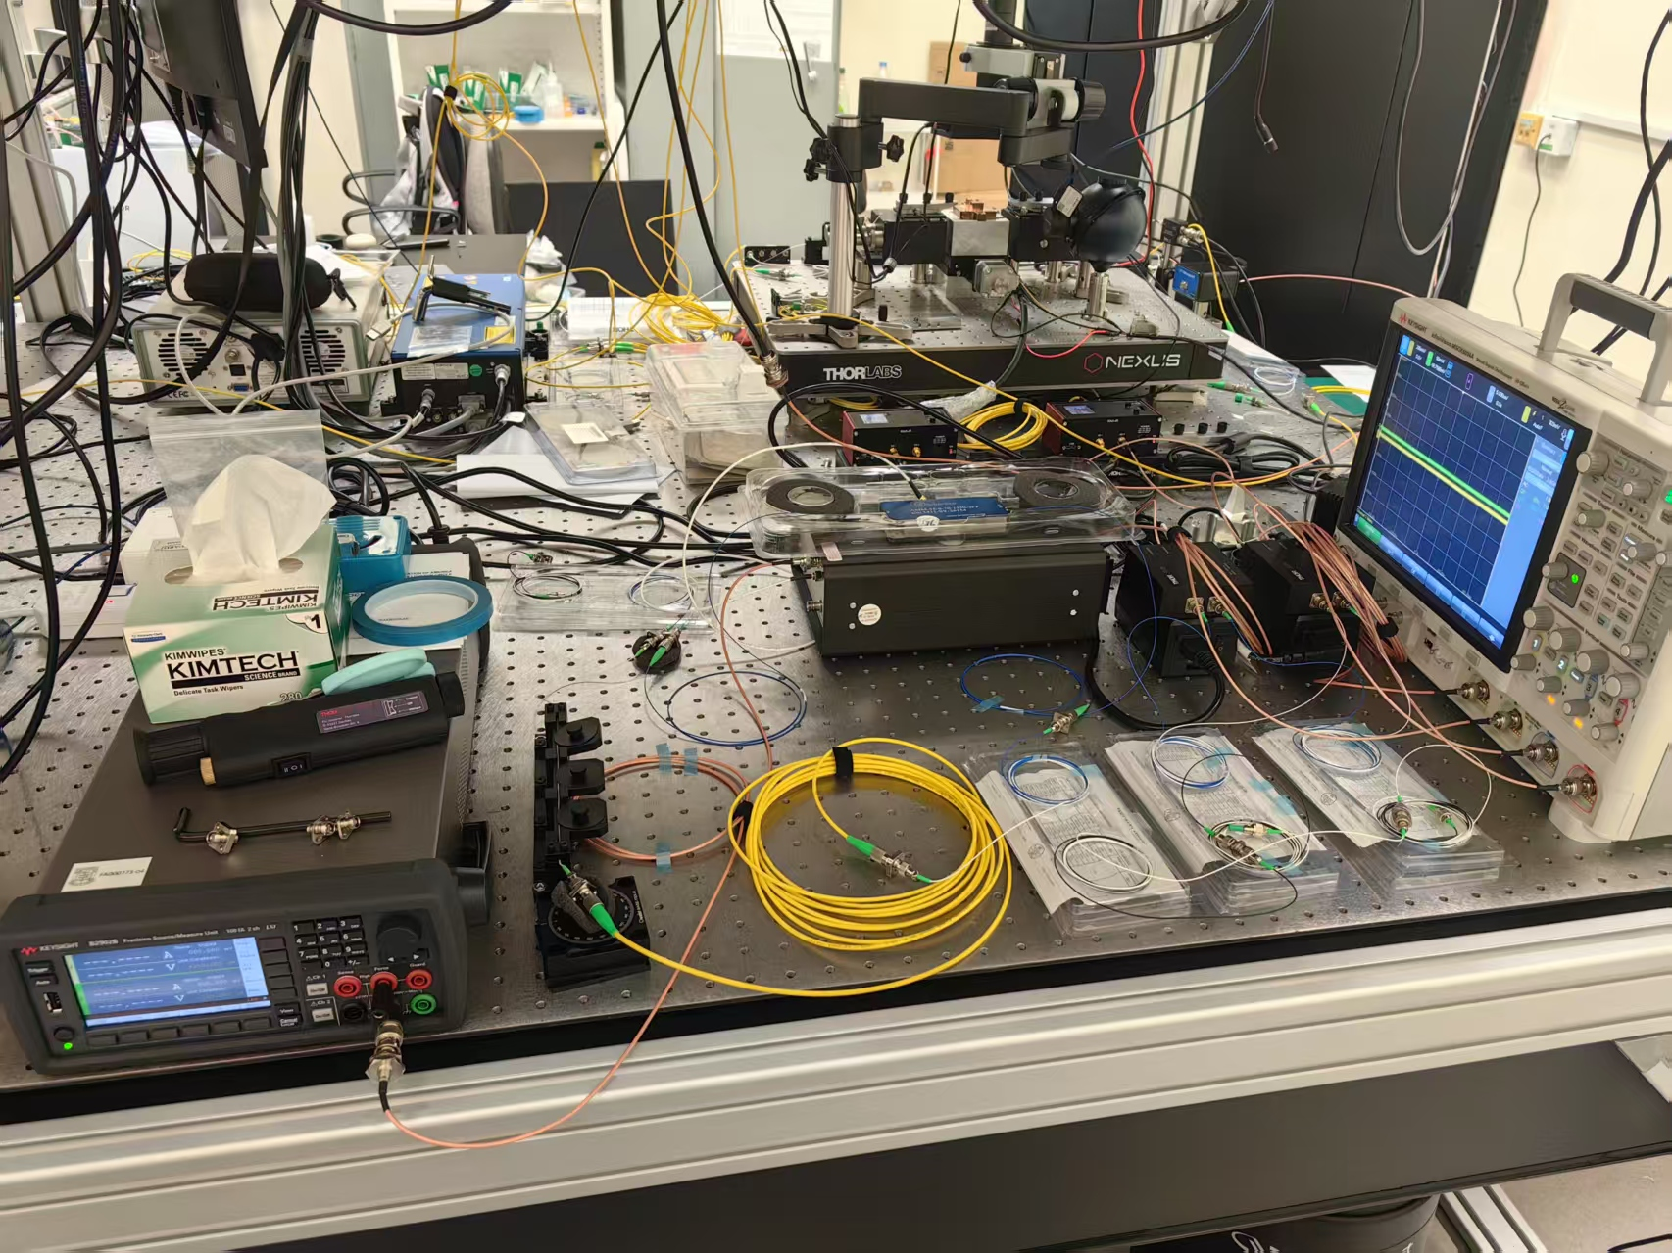
Relevant equipment
AOM: Brimrose AMM-55-8-70-1550-2FP (center frequency 55 MHz, modulation bandwidth 8 MHz, operating wavelength around 1550 nm)
BPD: Thorlabs PDB415C-AC x2
Oscilloscope: Keysight MSOX6004A

Slide 21
Note
Operating principle: Self-heterodyne detection for laser noise spectrum measurement. Two BPDs are deployed, and the noise spectrum is determined from the cross-correlation of their records. This approach can remove the contribution of PD noise to measured laser noise spectrum.
The oscilloscope should have a memory depth of >200 Mpts/ch such that all the data can be collected in a continuous measurement, which is important to reduce the impact of laser frequency drift.
The BPDs have a saturation power of 72 uW. The VOA should be tuned to accommodate this power limitation.
Fibers must not be connected to the BPDs very tightly, otherwise the BPDs may get damaged.
The polarization controller should be adjusted to maximize the amplitude of the 55-MHz oscillation measured by the oscilloscope.
The measurement script and data processing script are provided via this link.

Slide 22
Part V: Wafer-scale IV Test

Slide 23
Setup for wafer-scale IV test
Optical signal
Trigger signal
Ethernet/USB connection
Electrical signal
Probe station
Computer
SMU
DUT
SMU: source/measure unit
DUT: device under test

Slide 24
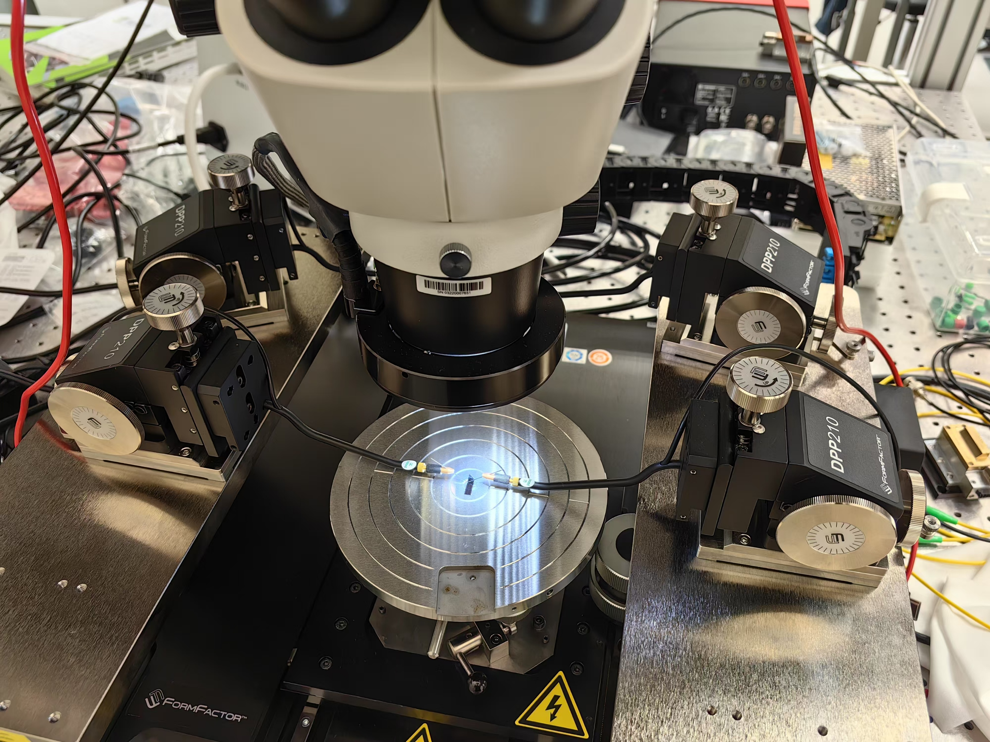
Relevant equipment
SMU: Keysight B2901BL or B2902B
Probe station: FormFactor MPS150

Slide 25
Note
Operating principle: Scan injection current and measure the corresponding voltage (or vice versa).
The probe station is movable and has a large range of motion in the horizontal directions. This significantly improves the IV testing efficiency.
The measurement script is provided via this link.

Slide 26
Scripts for automating measurement
Low-bandwidth transmittance/reflectance spectra measurement
High-bandwidth transmittance/reflectance spectra measurement
Optical spectrum characterization
IV testing
Laser LIV testing
Laser linewidth measurement

